Slide 1

Full Stack Development
Understanding MongoDB
Name : D.Seshu Reddy
Class : CSE-D
Roll No:22H51A05F0

Slide 2
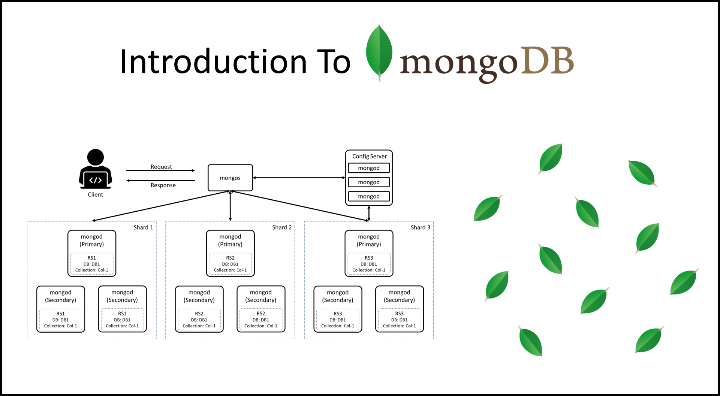
Introduction to MongoDB
MongoDB is a NoSQL database designed for scalability and flexibility.
It stores data in a JSON-like format known as BSON, allowing for rich data types.
Its schema-less nature enables rapid application development and iteration.
Notes:
Image source: https://digitalvarys.com/introduction-to-mongodb/

Slide 3
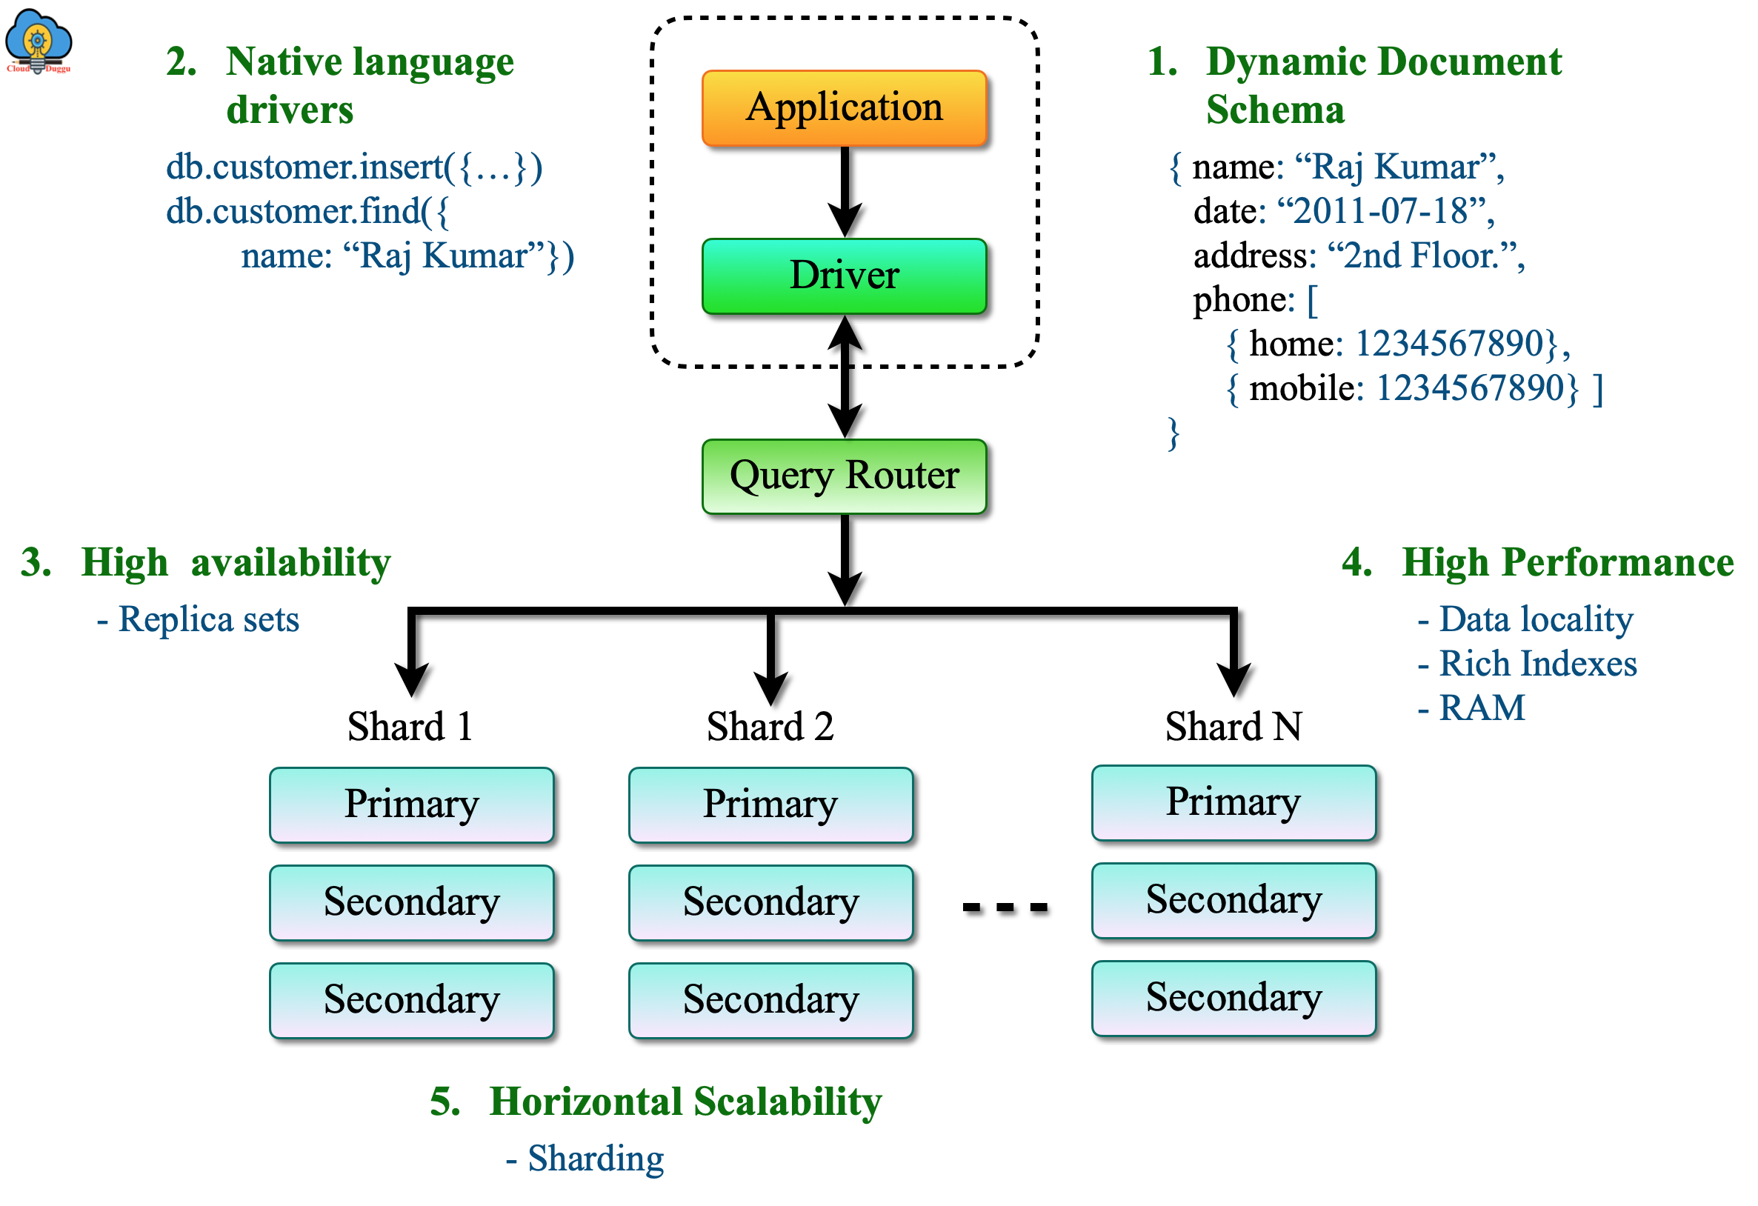
Features of MongoDB
MongoDB offers high availability through its replica set architecture.
It provides automatic sharding, distributing data across multiple servers.
Full-text search capabilities and geospatial queries are built-in features.
Notes:
Image source: https://www.cloudduggu.com/mongodb/architecture/

Slide 4
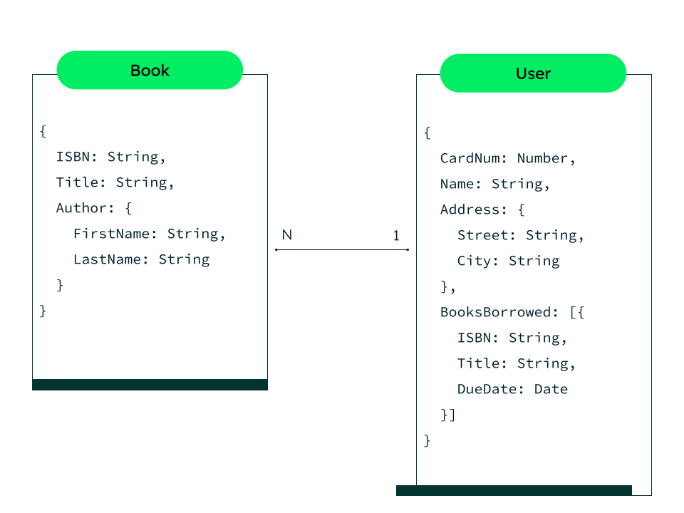
Data Model in MongoDB
The primary data structure is the document, which is similar to a JSON object.
Collections serve as containers for documents, grouping related data together.
Embedded documents and arrays allow for complex data relationships.
Notes:
Image source: https://www.mongodb.com/basics/data-modeling

Slide 5
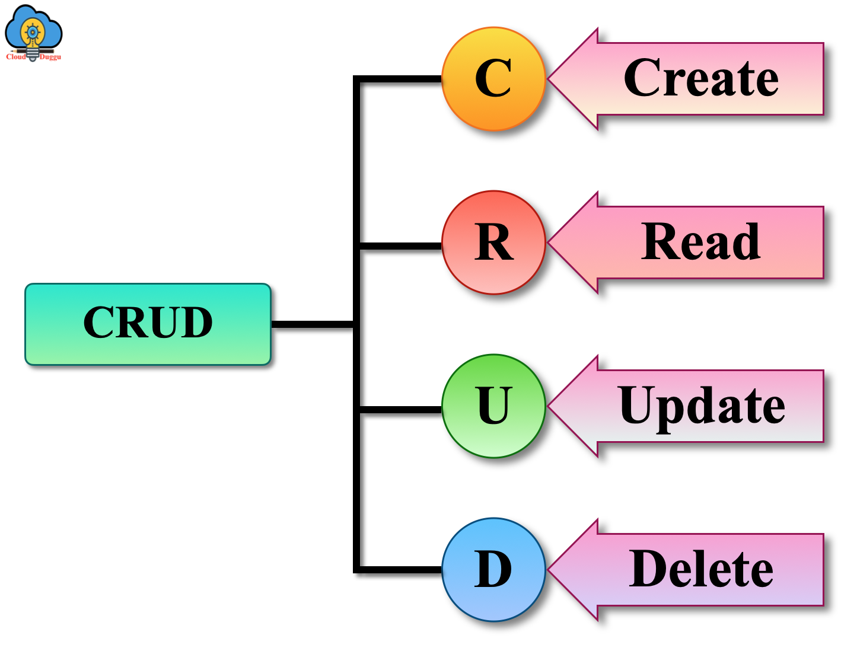
CRUD Operations
CRUD stands for Create, Read, Update, and Delete, which are the four basic operations.
MongoDB uses methods like insertOne, find, updateOne, and deleteOne for these operations.
These operations can be performed on both individual documents and multiple documents at once.
Notes:
Image source: https://www.cloudduggu.com/mongodb/crud-operations/

Slide 6
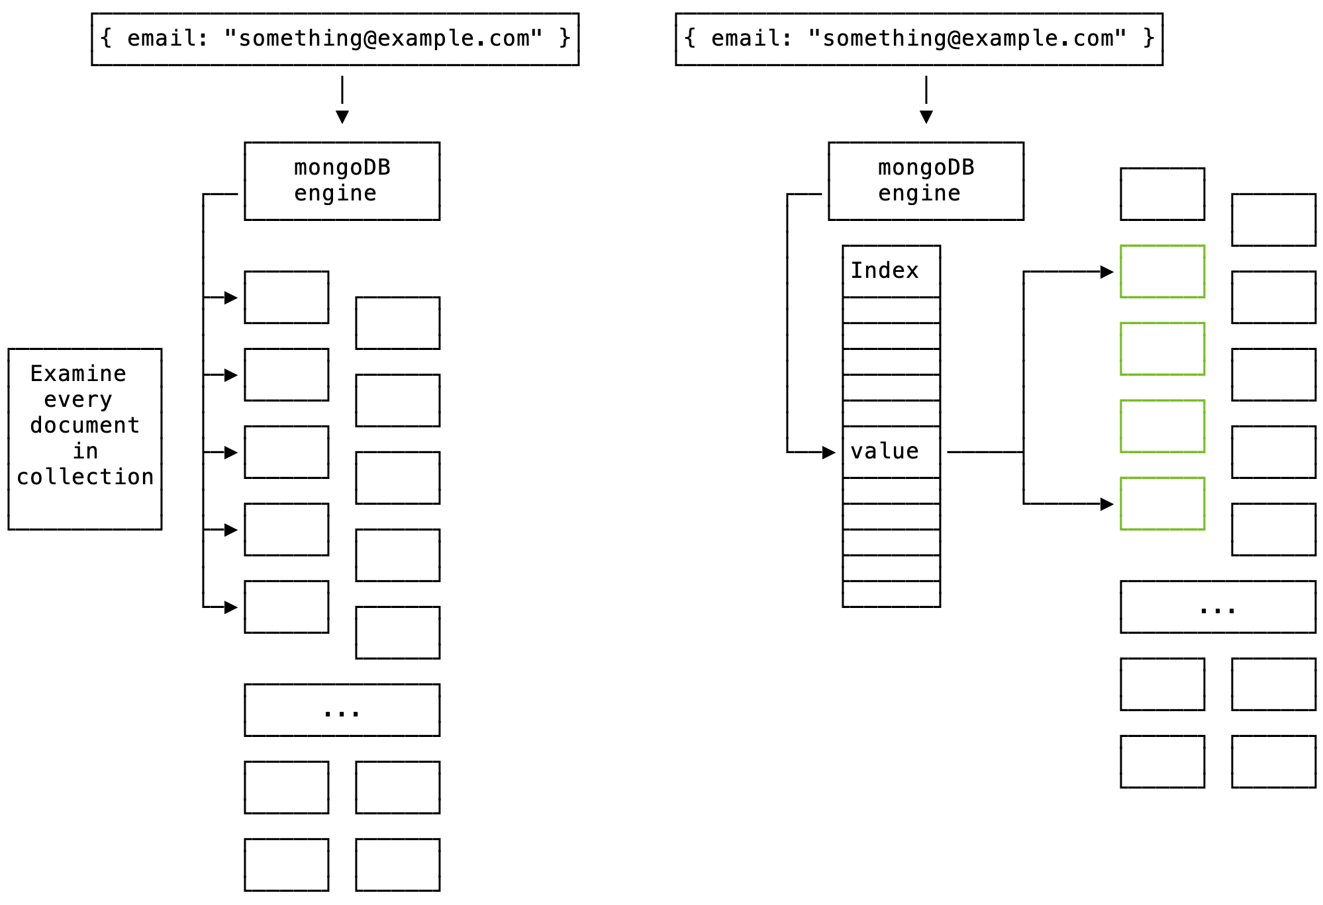
Indexing in MongoDB
Indexes improve query performance by allowing faster data retrieval.
MongoDB supports various index types, including single field, compound, and geospatial indexes.
Proper indexing strategies can greatly enhance application performance and efficiency.
Notes:
Image source: https://ifelse.io/2020/06/19/mongodb-performance-fundamentals-indexing-indexes

Slide 7
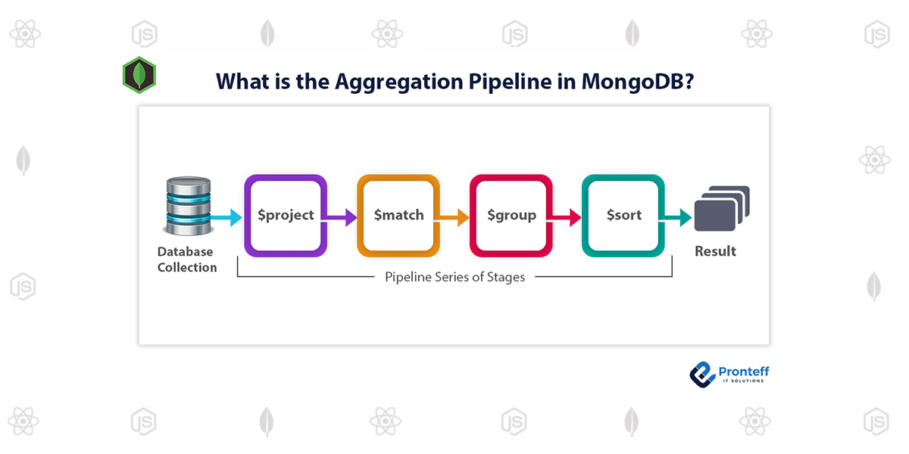
Aggregation Framework
The aggregation framework processes data and returns computed results.
It uses a pipeline approach, allowing for filtering, grouping, and sorting data.
Aggregation can be used for analytics and generating reports within the database.
Notes:
Image source: https://www.vrogue.co/post/mongodb-tutorials-aggregation-framework

Slide 8
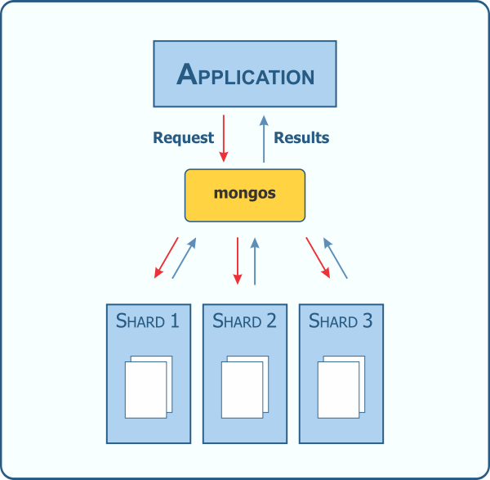
Scalability and Performance
MongoDB is designed for horizontal scalability, allowing it to handle large volumes of data.
Sharding distributes data across multiple servers to balance the load.
Performance optimization techniques include indexing, caching, and efficient schema design.
Notes:
Image source: https://www.kenwalger.com/blog/nosql/mongodb/mongodb-horizontal-scaling-sharding/

Slide 9

Security Features
MongoDB provides various security features, including authentication and authorization.
Role-Based Access Control (RBAC) allows administrators to manage user permissions effectively.
Data encryption is supported for both in-transit and at-rest data protection.
Notes:
Image source: https://www.slideshare.net/slideshow/security-features-in-mongodb-24/23420315

Slide 10
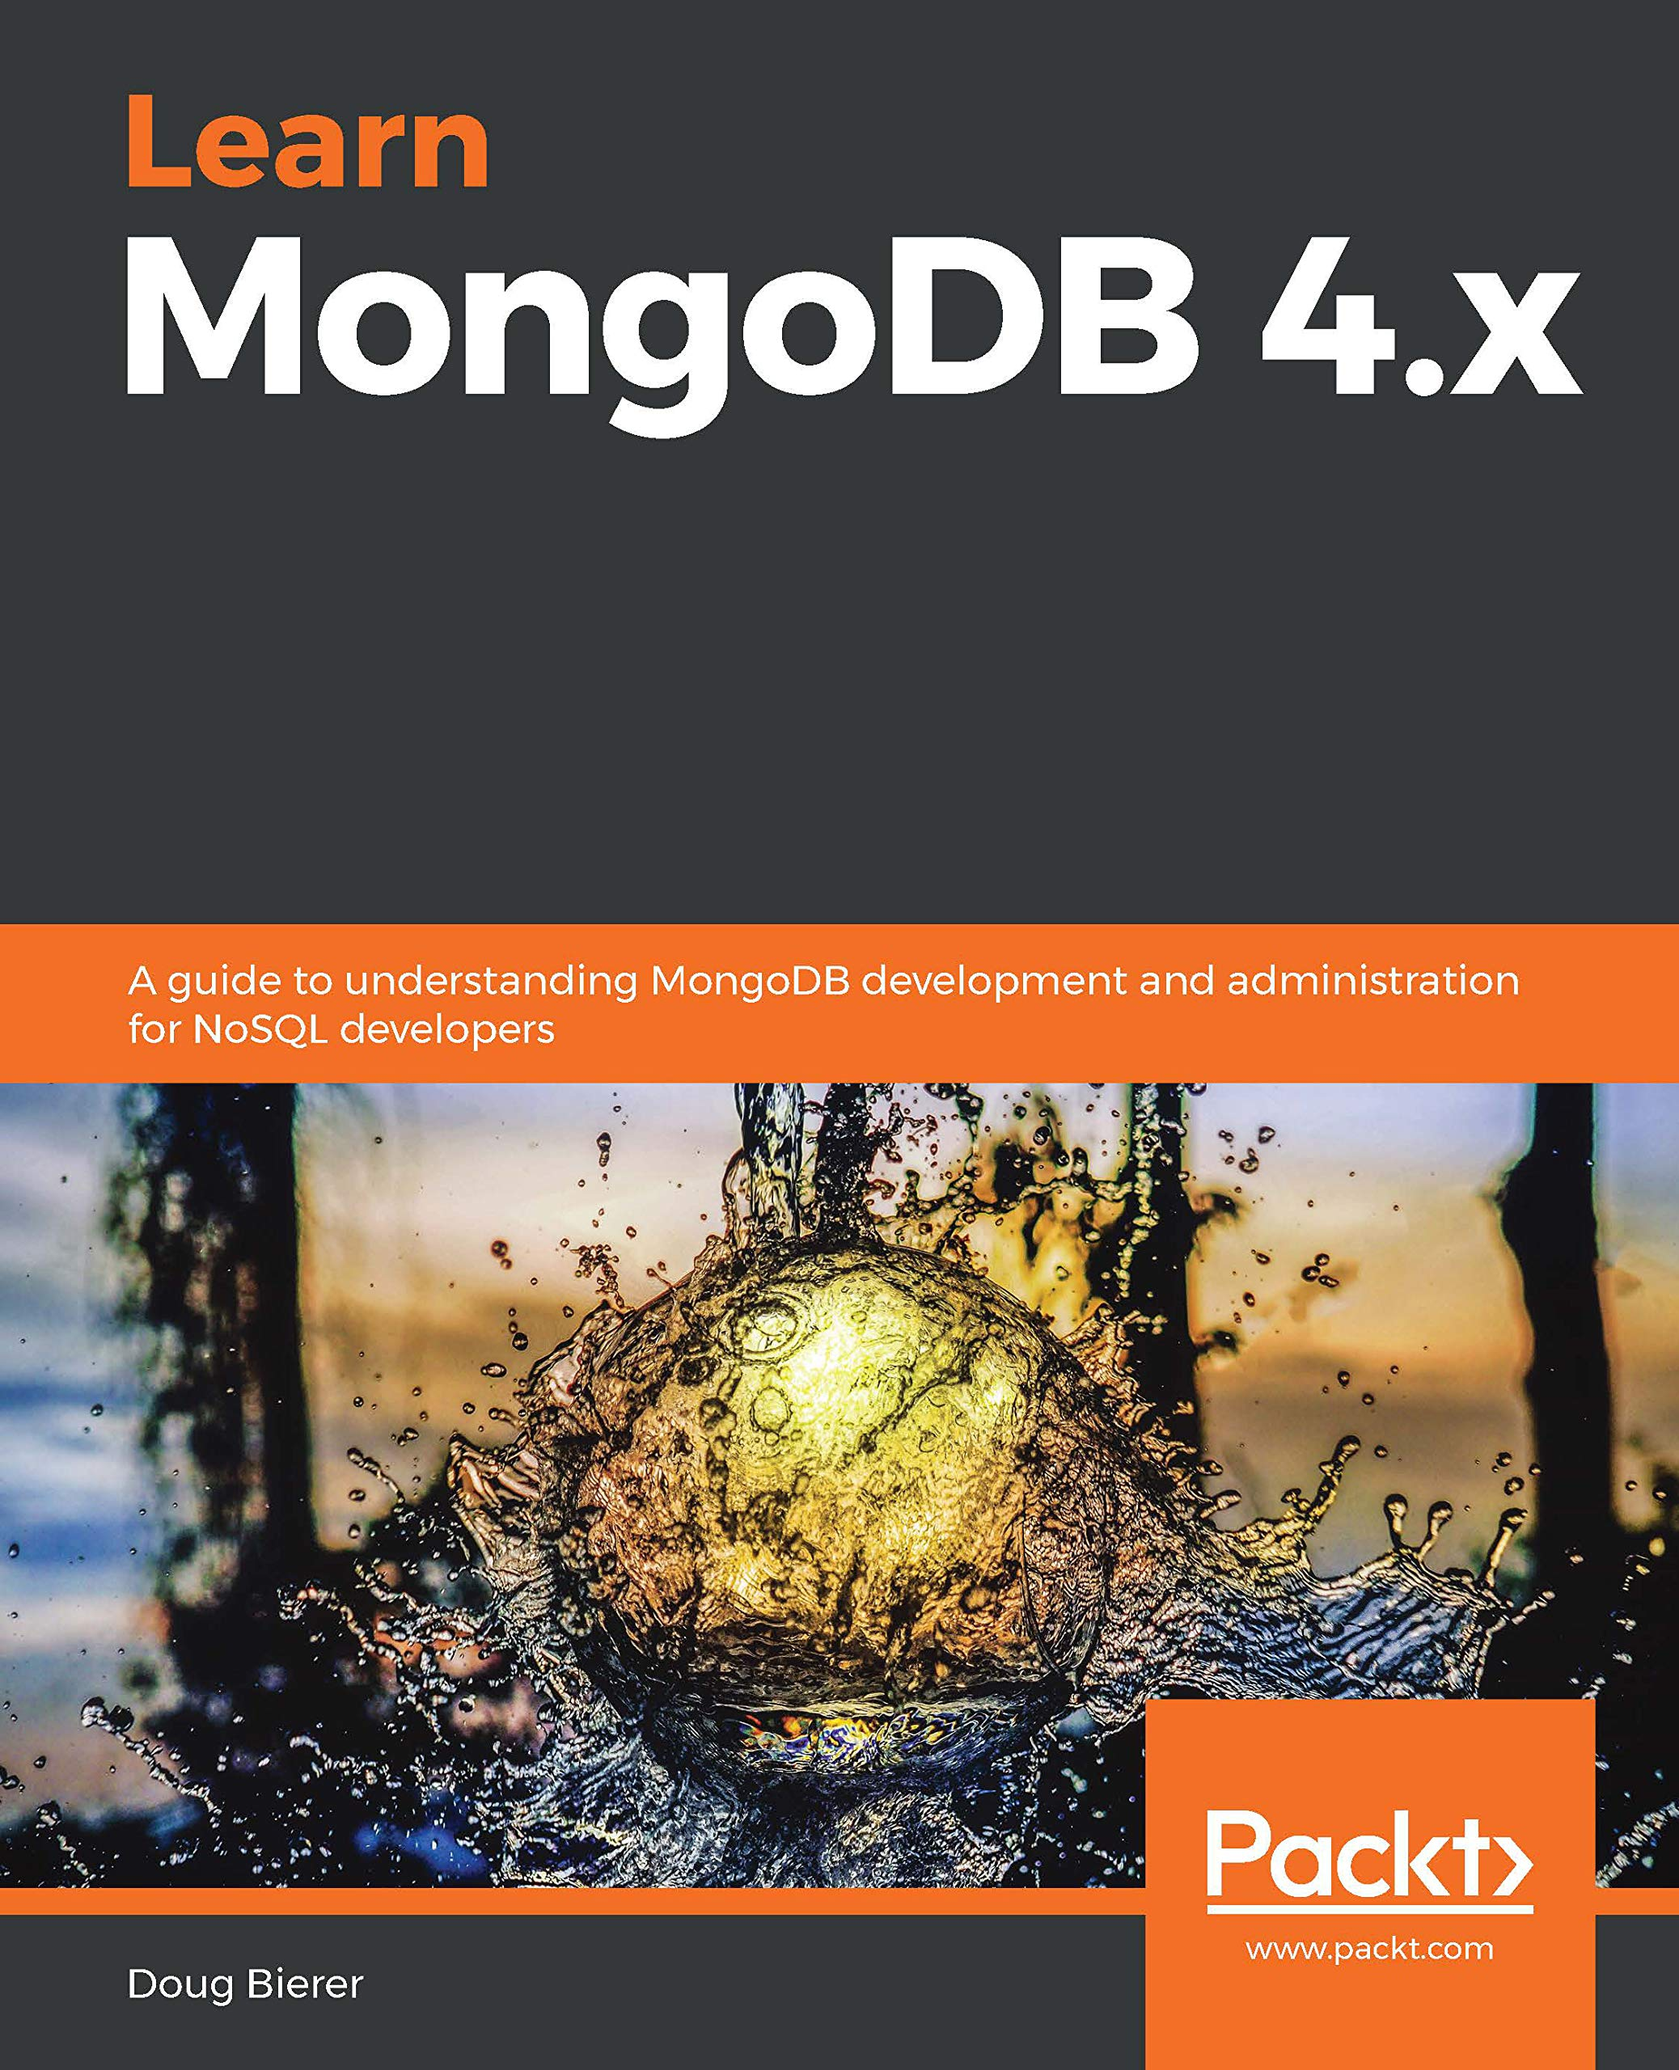
Conclusion and Resources
Understanding MongoDB empowers developers to build flexible and scalable applications.
Numerous resources are available, including official documentation, tutorials, and community forums.
Continuous learning and practice will enhance expertise in using MongoDB effectively.
Notes:
Image source: https://www.goodreads.com/en/book/show/55362428-learn-mongodb-4-x

Slide 11
THANK YOU….

